Slide 1
Name: Youssef Adel Ahmed Project: Control Car Systme

Slide 2
Description of project
Interrupt button to control of increasing speed of car
Interrupt button to decrease speed of car
Interrupt button to control of direction of car on condition that the speed of car is zero
Motors to describe the speed of car
Eeprom that have a specific password of car
Buzzer that is on when I entered a wrong password 3-times
Keypad to type the password of car
Ultrasonic to read the distance and stop car when distance <=30
Lcd that print * on place of password then welcome to the owner then print the status of moving the car and print ultrasonic distance then when I pushed interrupt button that print the speed of motor and direction of car
8-7sagemant that print time of motor that is on

Slide 3
Drivers that I used
HAL
Eeprom driver
Keypad
Lcd
Motor
Sevensagemant
Ultrasonic
LIB
Common macros(bit-math)
Std-types
MCAL
GIE
GPIO(dio)
Interrupt
Timers (timer0,timer2,pwm(of timer0&1)Timer1(icu))
SPI
Uart
Twi(i2c)

Slide 4
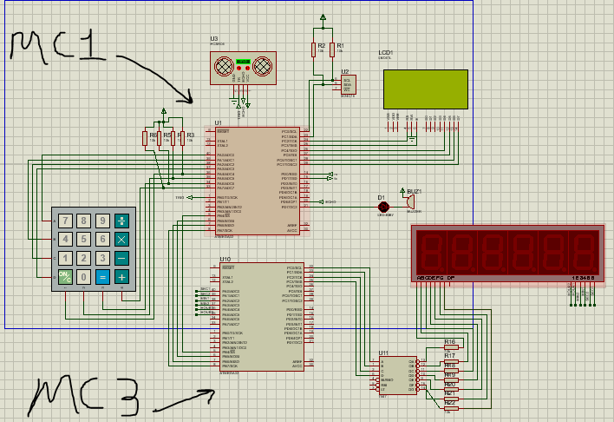
Images of preteus

Slide 5
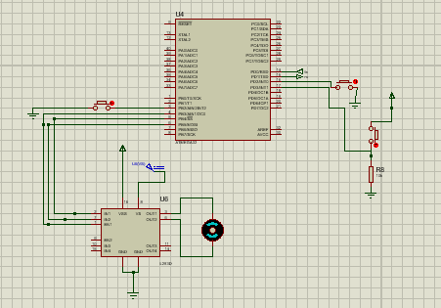
Images of preteus

Slide 6
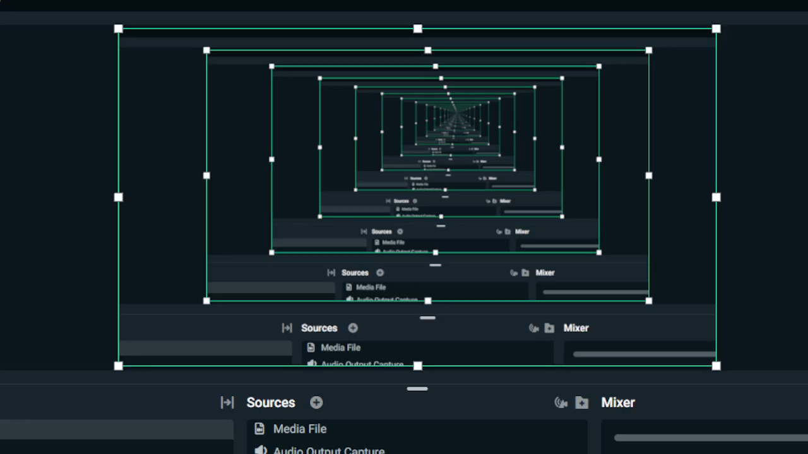
Video of proteus

